Slide 1
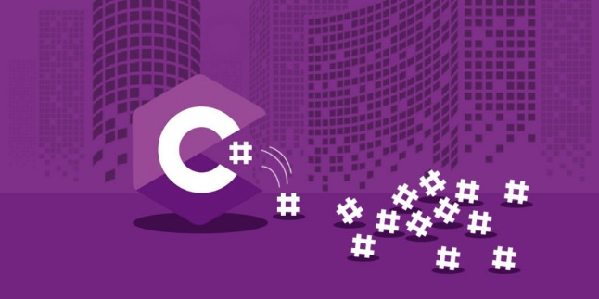
C# Basics

Slide 2
Introduction to C# and .NET
C# is designed by Anders Hejlsberg from Microsoft in 2000
C# is general purpose programming language
C# is object oriented (class-based) programming language
C# is used on .NET platform /.NET 6 is the latest version/
C# can be used for writing of Console, Desktop, Widows Services, Web apps, Mobile apps, Games and many more.
C# supports static typing, functional programming, generics and more features
C# and Microsoft documentation are generally quite good
C# documentation: https://docs.microsoft.com/en-us/dotnet/csharp/

Slide 3

Anders Hejlsberg
Danish software engineer who co-designed several programming languages and development tools. He is the original author of Turbo Pascal and co-chief of Delphi. Currently works in Microsoft as a lead architect and core developer of TypeScript.

Slide 4
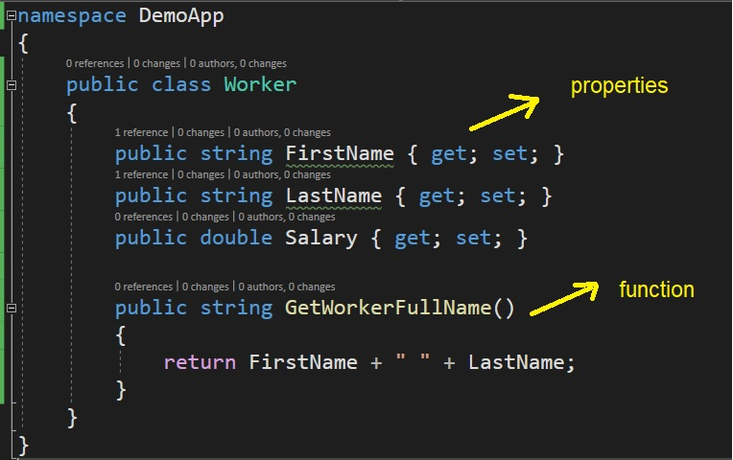
C# is object oriented programming language

Slide 5
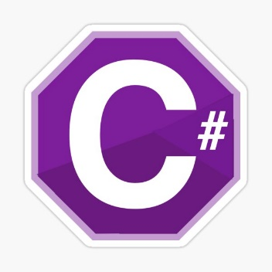


What is .NET?
.NET is a free, cross-platform, open source developer platform for building many different types of applications.
With .NET, you can use multiple languages, editors, and libraries to build for web, mobile, desktop, games, and IoT.
The two main components of .NET are CoreCLR and CoreFX
You can write on C#, F#, Visual Basic and other programming languages.

Slide 6
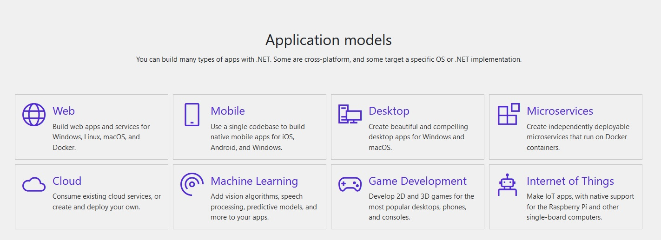
.NET platform /whole new world/

Slide 7
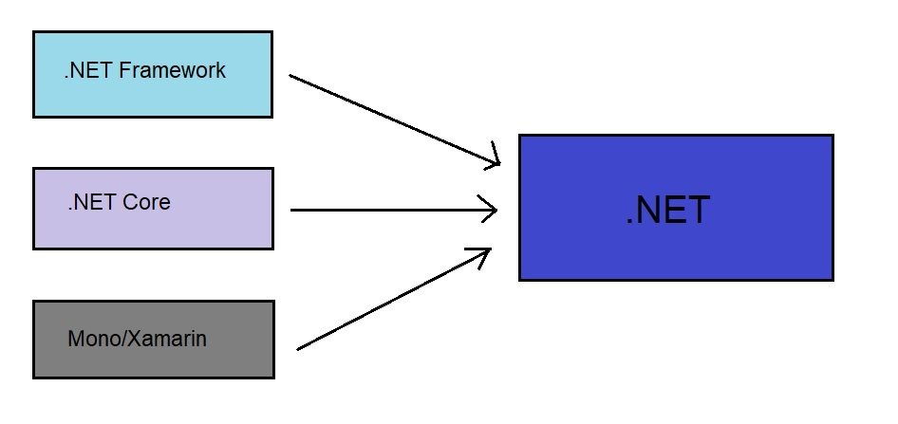
.NET ecosystem

Slide 8

.NET = The Ecosystem
Languages
Runtimes
Libraries

Slide 9
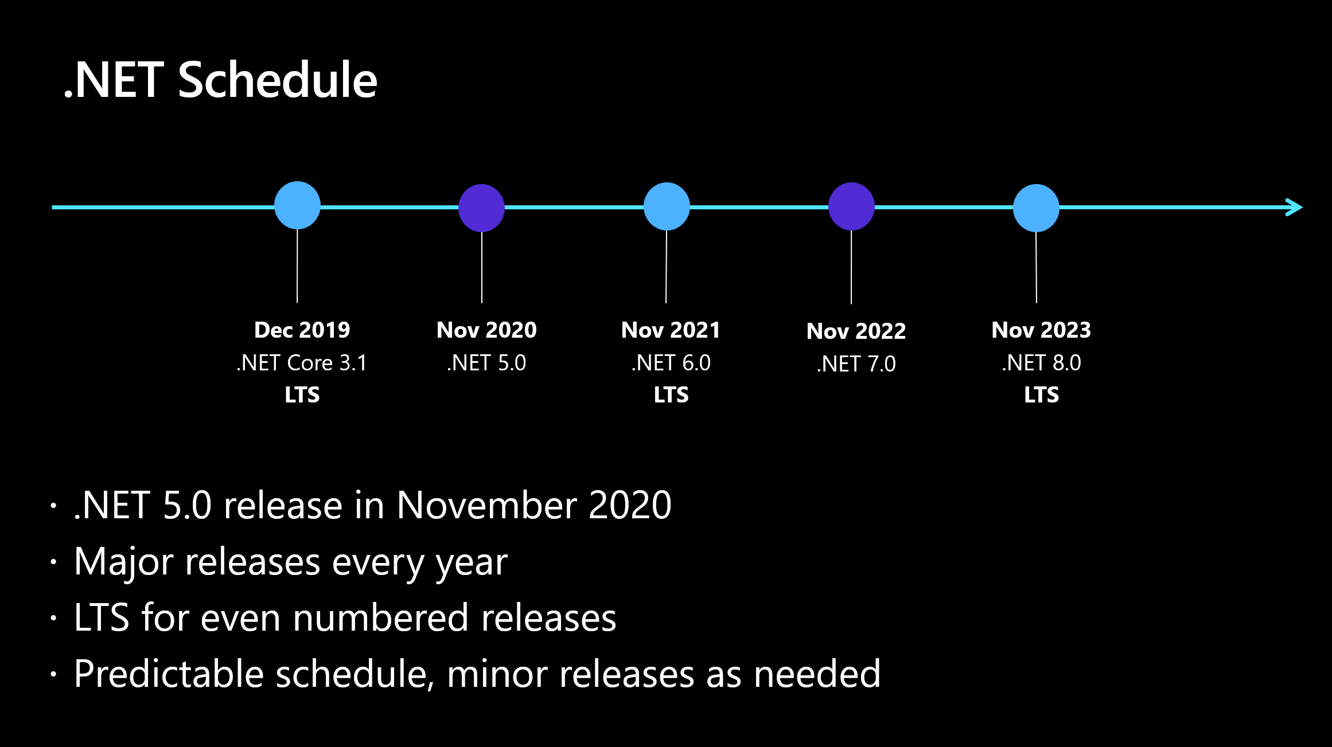
.NET Schedule

Slide 10
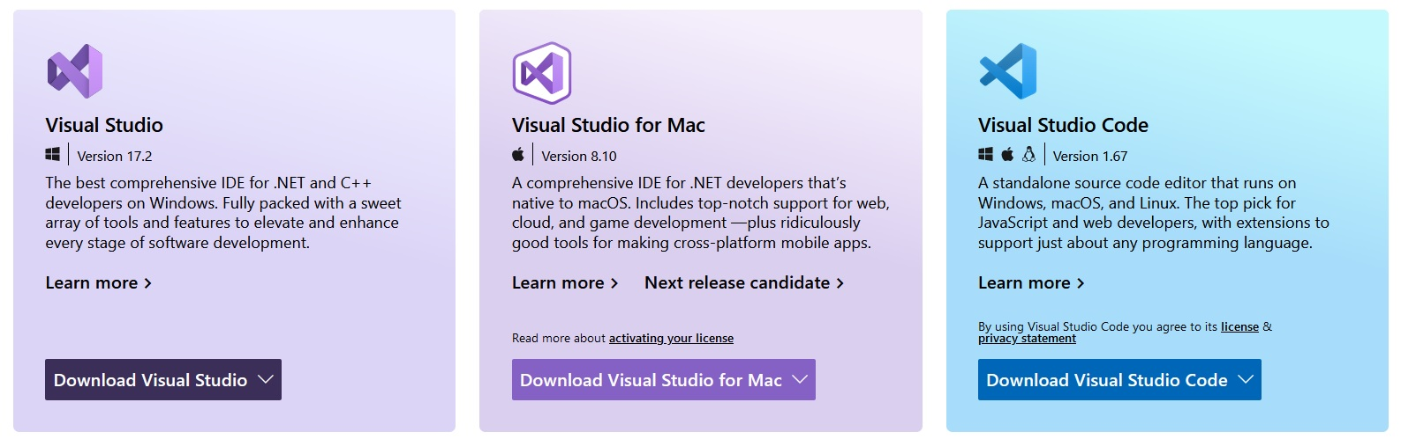
What is an IDE?
IDE - Integrated Development Environment is software that helps us to write/debug/run our source more easily and to create our final programs in better way.
An IDE typically consists of:
Source Code Editor
Local Build Automation
Debugger

Slide 11
What is compiler?
A compiler is a special program that translates a programming language's source code into machine code, bytecode or another programming language. The source code is typically written in a high-level, human-readable language such as C#, Java, C++, etc.

